Slide 1
Introduction to philosophy Lecture 7
PHI1101
Dr. Lucas Scripter
Lecturer in General Education
School of Humanities and Social Sciences
Chinese University of Hong Kong, Shenzhen

Slide 2

Three ways of conceiving of philosophy
Philosophy as a Way of Life
Philosophy as the Foundation of the Sciences
Philosophy as Conceptual Analysis

Slide 3
review

Slide 4

Descartes’ vision of philosophy

Slide 5
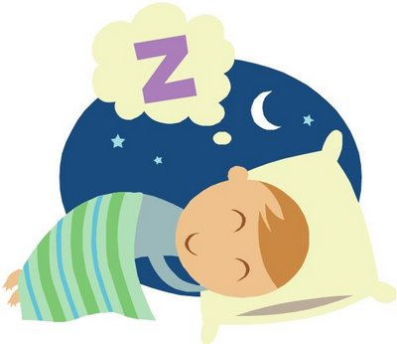

Descartes’ radical skepticism: two thought experiments

Slide 6
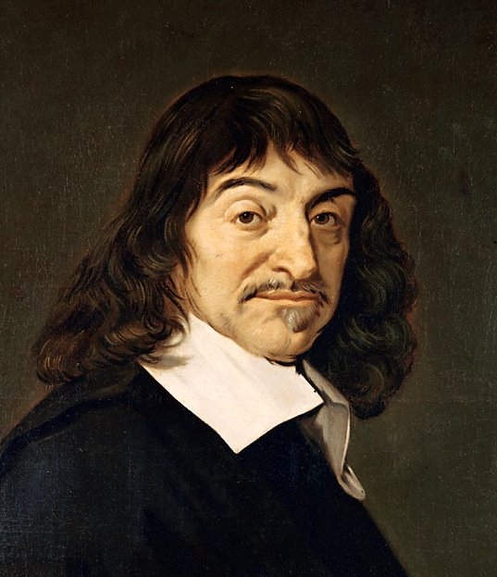
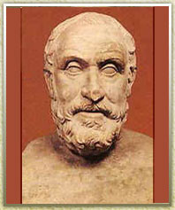
Two kinds of skepticism
Cartesian
ancient

Slide 7

First principle of philosophy cogito, ergo sum
I think, therefore I am.
The fundamental and indubitable principle of philosophy: the I must exist, because it is the I that is doubting.
Implication: the I = a thinking thing.

Slide 8




Descartes’ ontological arguments

Slide 9

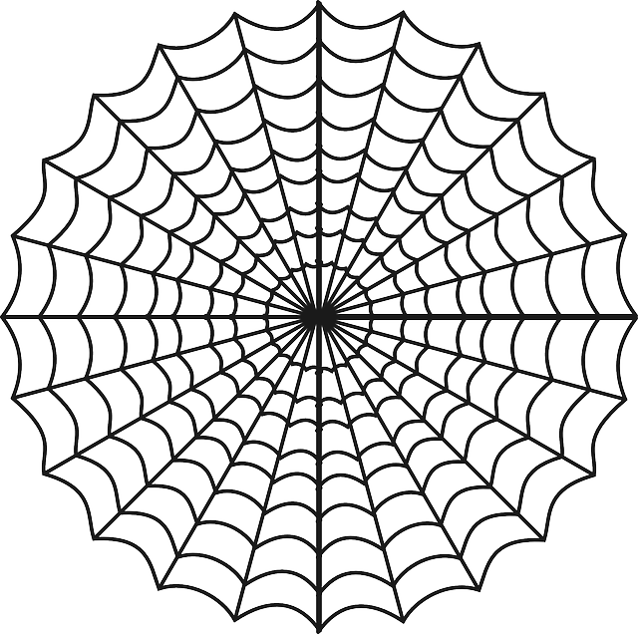
Two models of epistemology
Foundationalist
Coherentist

Slide 10
Bertrand russell

Slide 11
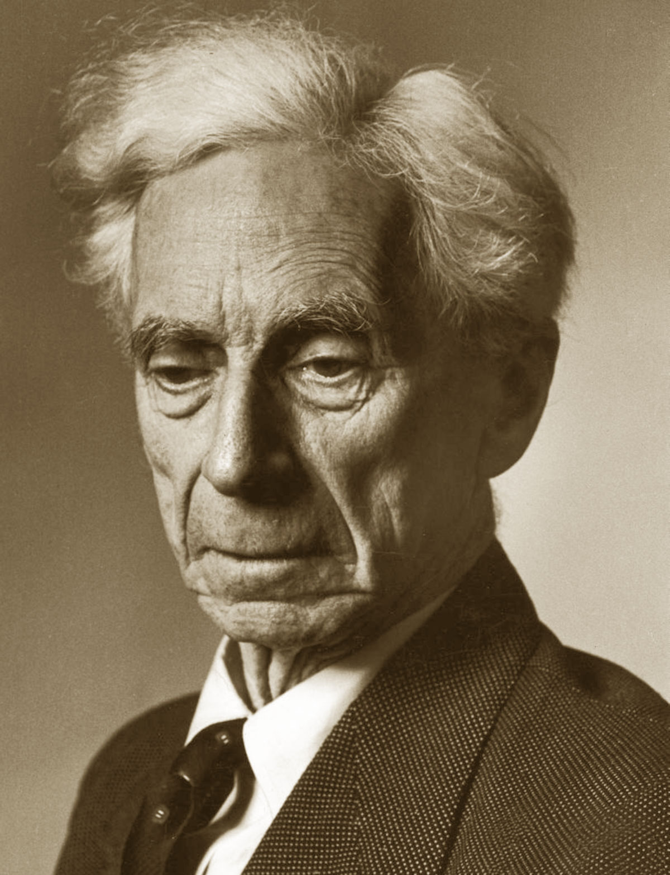
Bertrand Russell: selected writings
A Free Man’s Worship and Other Essays (1903)
‘On Denoting’, Mind (1905)
The Problems of Philosophy (1912)
Mysticism and Logic (1918)
The Analysis of Mind (1921)
Why I am Not a Christian (1927)
Marriage and Morals (1929)
The Conquest of Happiness (1930)
In Praise of Idleness and Other Essays (1935)
Common Sense and Nuclear Warfare (1959)
Has Man a Future (1961)

Slide 12
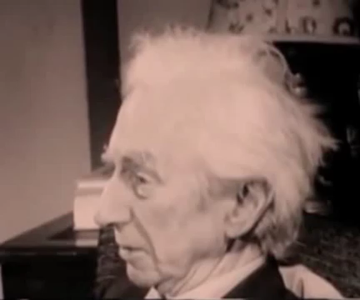
Russell on his vices

Slide 13
Russell’s the problems of philosophy

Slide 14
Opening question
Russell’s Opening Question in The Problems of Philosophy:
“Is there any knowledge in the world which is so certain that no reasonable man could doubt it?” (PP, p. 1)
Discussion question: is this the same question that Descartes’ asked?

Slide 15
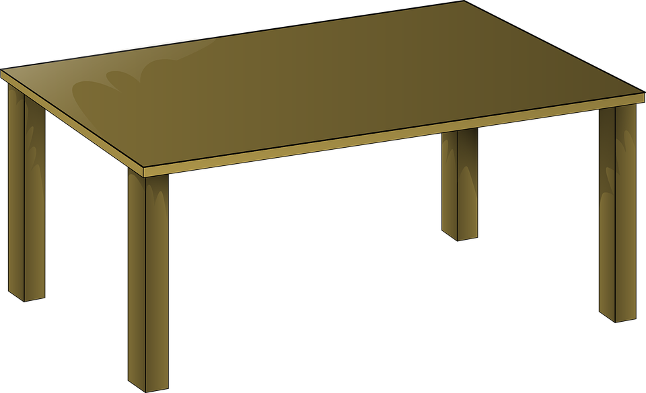
Example from ordinary experience

Slide 16
Initial conclusion
“the real table, if there is one, is not the same as what we immediately experience by sight or touch or hearing. The real table, if there is one, is not immediately known to us at all, but must be an inference from what is immediately known.” (PP. 3-4)

Slide 17
Sense-data v. physical objects
Russell makes a distinction between (1) sense-data and (2) physical objects
Sense-data: “things that are immediately known in sensation: such things as colours, sounds, smells, hardnesses, roughnesses, and so on.” (PP, p. 4)
Problem: how do we understand the relationship between sense-data and physical objects or matter?

Slide 18
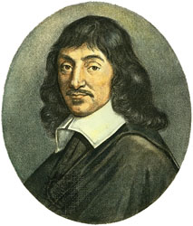
Russell’s Critique of descartes
Russell argues that Descartes’ “I think, therefore, I am” doesn’t prove the certainty of the existence of the self.
We can only be certain of momentary sense-data—not a lasting self.
“But the real Self is as hard to arrive at as the real table, and does not seem to have that absolute, convincing certainty that belongs to particular experiences. When I look at my table and see a certain brown colour, what is quite certain at once is not ‘I am seeing a brown colour’, but rather, ‘a brown colour is being seen’. This of course involves something (or somebody) which (or who) sees the brown colour; but it does not of itself involve that more or less permanent person whom we call ‘I’. So far as immediate certainty goes, it might be that the something which sees the brown colour is quite momentary, and not the same as the something which has some different experience the next moment.” (PP, p. 8)

Slide 19

Existence of matter?
The existence of physical objects (matter) is not logically provable BUT it is the simplest explanation of the phenomena of sense-data.
“we can never prove the existence of things other than ourselves and our experiences. No logical absurdity results from the hypothesis that the world consists of myself and my thoughts and feelings and sensations, and that everything else is mere fancy…But although this is not logically impossible, there is no reason whatever to suppose that it is true; and it is, in fact, a less simple hypothesis, viewed as a means of accounting for the facts of our own life, than the common-sense hypothesis that there really are objects independent of us, whose action on us causes our sensations.” (PP, p. 10)

Slide 20
Philosophy as the organization of instinctive beliefs
Belief in the existence of the external world = “instinctive belief.” (p. 11)
“All knowledge, we find, must be built up upon our instinctive beliefs, and if these are rejected, nothing is left. But among our instinctive beliefs some are much stronger than others, while many have, by habit and association, become entangled with other beliefs, not really instinctive, but falsely supposed to be part of what is believed instinctively.”
“Philosophy should show us the hierarchy of our instinctive beliefs, beginning with those we hold most strongly, and presenting each as much isolated and as free from irrelevant additions as possible. It should take care to show that, in the form in which they are finally set forth, our instinctive beliefs do not clash, but form a harmonious system. There can never be any reason for rejecting one instinctive belief except that it clashes with others, thus, if they are found to harmonize, the whole system becomes worthy of acceptance…Hence, by organizing our instinctive beliefs and their consequences, by considering which among them is most possible, if necessary, to modify or abandon, we can arrive, on the basis of accepting as our sole data what we instinctively belief, at an orderly systematic organization of our knowledge, in which, though the possibility of error remains, its likelihood is diminished by the interrelation of the parts and by the critical scrutiny which has preceded acquiescence.” (PP, p. 12)

Slide 21
Two kinds of knowledge
Knowledge by acquaintance
Knowledge by description
Direct awareness
Non-inferential
Examples: color patches, special position
Description = ‘a so-and-so’ (ambiguous) or ‘the so-and-so’ (definite)
Knowledge that one object fits a certain description/has a property x.
Knowledge by description is built out of things with which we are acquainted:
“Every proposition which we can understand must be composed wholly of constituents with which we are acquainted.” (PP, p. 32)

Slide 22

Types of knowledge by acquaintance
Russell identifies several types of object which we can know by acquaintance:
Sense-data (color patch here now)
Memory (experiences in the past/knowledge that things have passed—basis of inferential knowledge of the past)
Introspection/self-consciousness (my states of mind—desire, intention, etc. No awareness of a permanent ‘self’ but rather momentary self)
Universals (greenness, hardness, diversity)

Slide 23
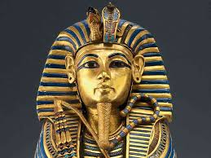
Knowledge by description
Knowledge by Description makes possible knowledge beyond those things we have privately experienced. It is the basis for much knowledge of the world:
“The chief importance of knowledge by description is that it enables us to pass beyond the limits of our private experience. In spite of the fact that we can only know truths which are wholly composed of terms we have experienced in acquaintance, we can yet have knowledge by description of things which we have never experienced. In view of the very narrow range of our immediate experience, this result is vital, and until it is understood, much of our knowledge must remain mysterious and therefore doubtful.” (PP, p. 32)

Slide 24
How do we extend our knowledge?

Slide 25

Question: How do we know the sun will rise again tomorrow?

Slide 26

Problem of induction
Key distinction: (1) expectation of uniformity v. (2) justification of uniformity:
“We have to distinguish between the fact that past uniformities cause expectations as to the future, from the question whether there is any reasonable ground for giving weight to such expectations after the question of their validly has been raised.”
What justifies our expectation that the future will be like stable patterns of the past?
“The man who has fed the chicken every day throughout its life at last wrings its neck instead…”
~Russell, Problems of Philosophy, p. 35

Slide 27
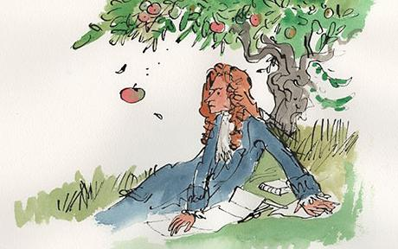
What about natural laws?
Russell objects that there are two problems with appealing to natural law:
Practical Uncertainty: “The first is that, even if some law which has no expectations applies to our case, we can never, in practice, be sure that we have discovered that law and not one to which there are exceptions.”
Belief in uniform law based on induction: “The second is that the reign of law would seem to be itself only probable, and that our belief it will hold in the future, or in unexamined cases in the past, is itself based upon the very principle we are examining.” (PP, p. 36)

Slide 28
Russell’s inductive principle
Principle of Induction:
“(a) When a thing of a certain sort A, has been found to be associated with a thing of a certain other sort B, and has never been found dissociated from a thing of the sort B, the greater the number of cases in which A and B have been associated, the greater is the probability that they will be associated in a fresh case in which one of them is known to be present;
(b) Under the same circumstances, a sufficient number of cases of association will make the probability of a fresh association nearly a certainty, and will make it approach certainty without limit.” (Problems of Philosophy, p. 37)

Slide 29
Status of the inductive principle
The inductive principle cannot be proven inductively:
“The inductive principle…is equally incapable of being proved by an appeal to experience…All arguments which, on the basis of experience, argue as to the future or the unexperienced parts of the past or present, assume the inductive principle; hence we can never use experience to prove the inductive principle without begging the question. Thus we must either accept the inductive principle on the ground of its intrinsic evidence or forgo all justification of our expectations about the future.” (PP, p. 38)
“Thus all knowledge which, on a basis of experience, tells us something about what is not experienced, is based upon a belief which experience can neither confirm nor confute, yet which, at least in its more concrete applications, appears to be as firmly rooted in us as many of the facts of experience.” (PP, p. 38)
Inductive Principle
Inductive Principle

Slide 30
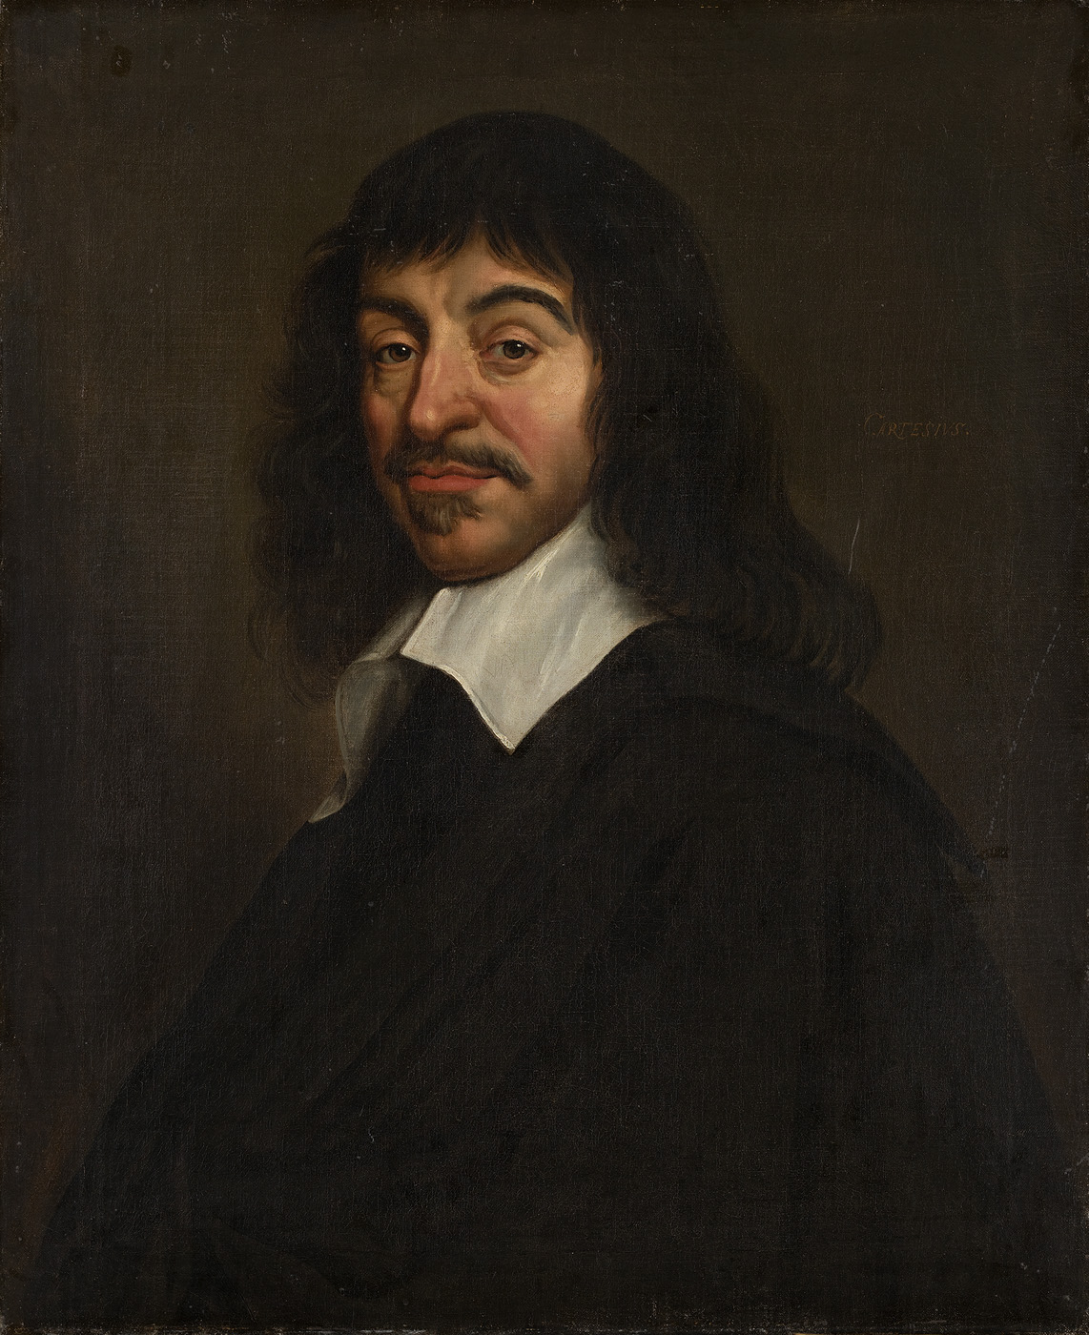
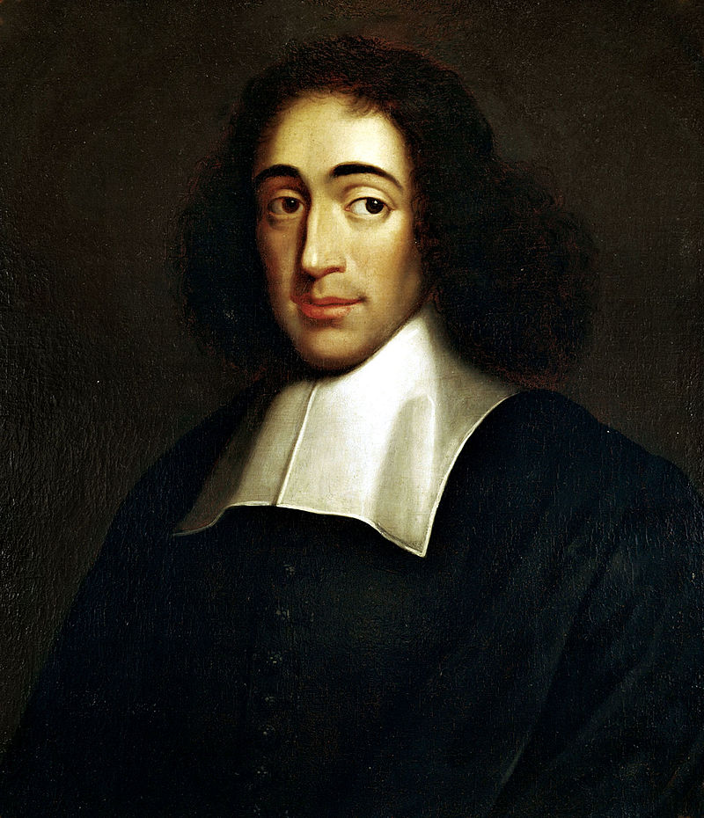
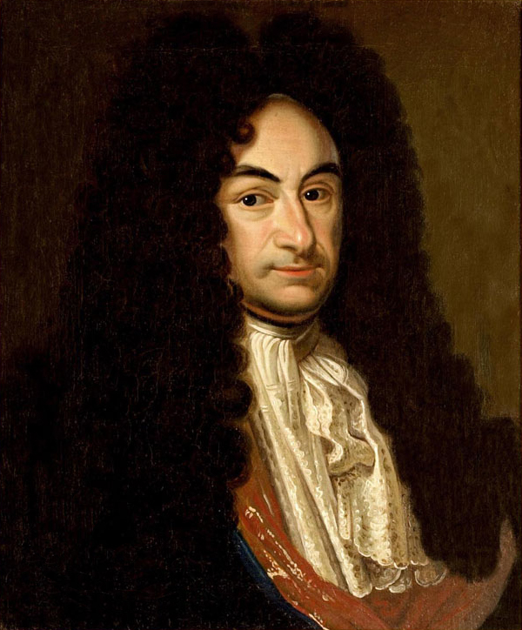
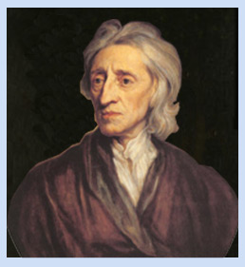
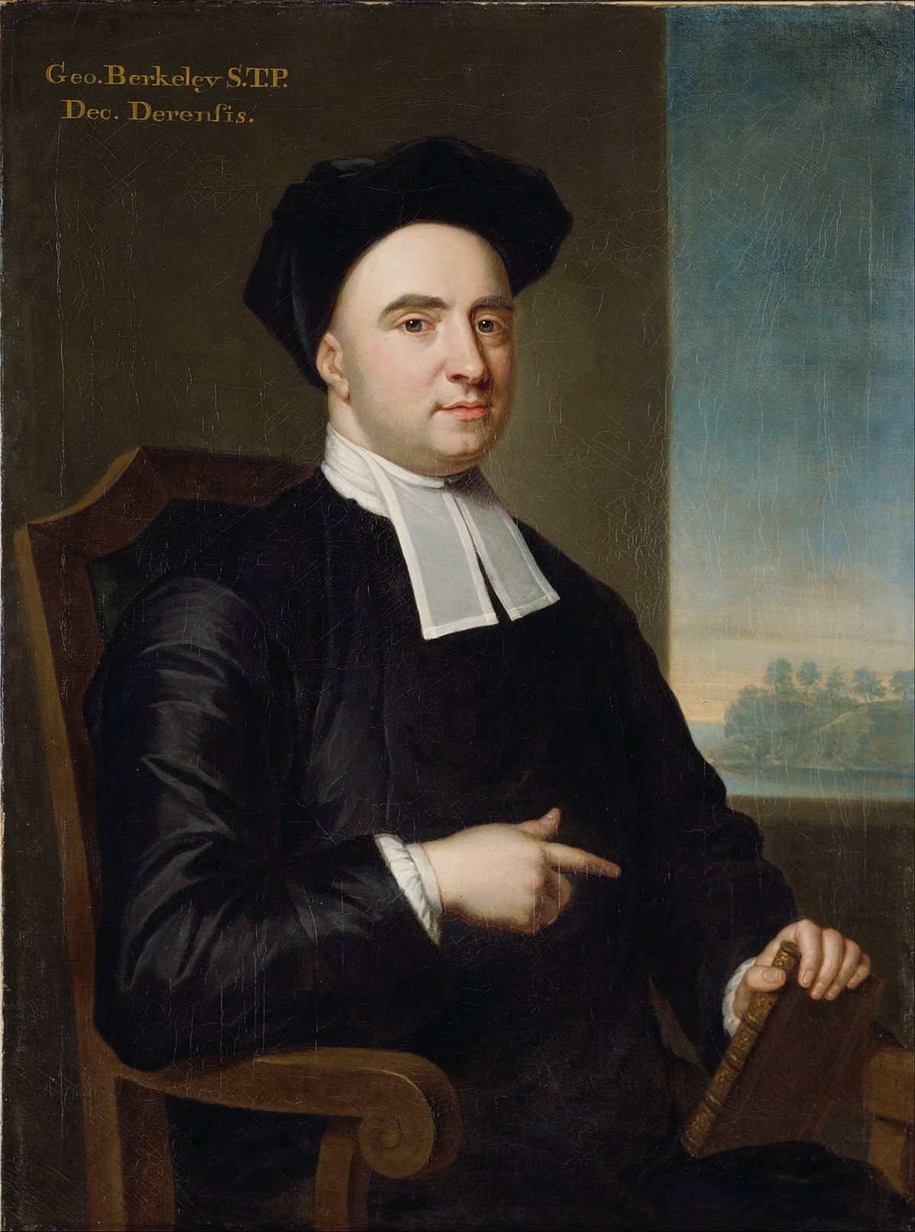
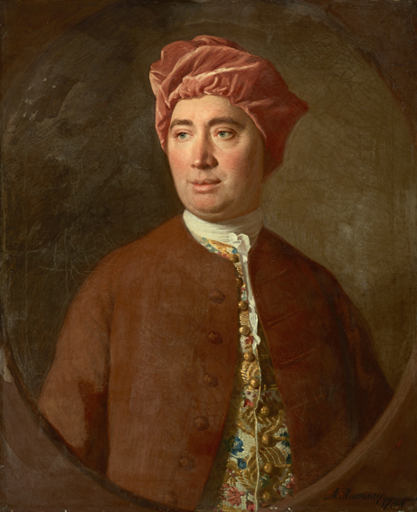
Background: debate between rationalists & empiricists
Rationalists
Rene Descartes (1596-1650)
Baruch Spinoza (1632-1677)
Gottfried Wilhelm Leibniz (1646-1716)
Empiricists
John Locke (1632-1704)
George Berkeley (1685-1753)
David Hume (1711-1776)

Slide 31

Russell’s compromise
What the Rationalists got Right:
logical principles are not justified by experience: “It must be admitted…that logical principles are known to us, and cannot be themselves proved by experience, since all proof presupposes them. In this, therefore, which was the most important point of the controversy, the rationalists were right.”
What the Empiricists got Right:
Experience ‘elicits’ our knowledge of logical principles: “even that part of our knowledge which is logically independent of experience (in the sense that experience cannot prove it) is yet elicited and caused by experience.” (PP, p. 41)
Knowledge of existence presupposes experience: “Nothing can be known to exist except by the help of experience…if we wish to prove that something of which we have no direct experience exists, we must have among our premises the existence of one or more things of which we already have direct experience.” (PP, p. 42)
If A, then B
A
Therefore, B

Slide 32

Russell on a priori knowledge
A priori: justified without appeal to experience.
A posteriori: justified by appeal to experience.
“the scope and power of a priori principles is strictly limited. All knowledge that something exists must be in part dependent on experience. When anything is known immediately, its existence is known by experience alone; when anything is proved to exist, without being known immediately, both experience and a priori principles must be required in the proof. Knowledge is called empirical when it rests wholly or partly upon experience. Thus all knowledge which asserts existence is empirical and the only a priori knowledge concerning existence is hypothetical giving connexions among things that exist or may exist, but not giving actual existence.” (PP, p. 42)

Slide 33
Kinds of a priori knowledge
Russell thinks there are three types of a priori knowledge:
Propositions of logic
Pure mathematics
Propositions of Ethics
“We judge, for example, that happiness is more desirable than misery, knowledge than ignorance, goodwill than hatred, and so on. Such judgments must, in part at least, be immediate and a priori. Like our previous a priori judgments, they may be elicited by experience, and indeed they must be…But it is fairly obvious they cannot be proved by experience.” (PP, p. 42)

Slide 34
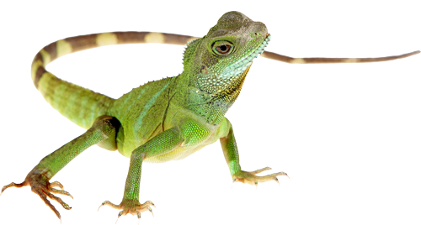


Russell on universals
Russell believed that we have knowledge of universals and, indeed, that all propositions involve at least one universal (PP, p. 53).
Russell thinks that judgments about particulars involve hidden universals.
Example: ‘Charles I’s head was cut off’
Universal: Head
Universal: Cutting off

Slide 35
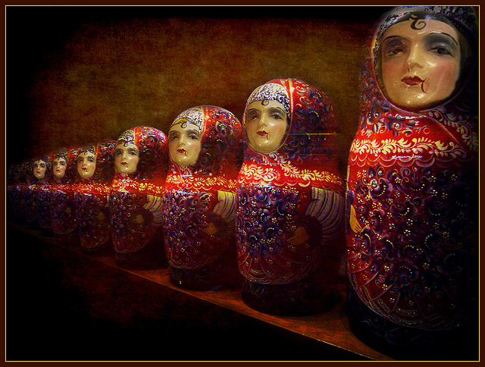
Russell’s defense of universals
Russell argues that the rejection of universals is self-defeating:
“the resemblance required will have to be a universal…at least we shall be forced to admit resemblance as a universal. The relation of resemblance, therefore, must be a true universal. And having been forced to admit this universal, we find that it is no longer worth while to invent difficult and unplausible theories to avoid the admission of such universals as whiteness and triangularly.” (PP, p. 5)

Slide 36
Russell’s two worlds
The World of Being
“The world of being is unchangeable, rigid, exact, delightful to the mathematician, the logician, the builder of metaphysical systems, and all who love perfection more than life.”
The World of Existence
“The world of existence is fleeting, vague, without sharp boundaries, without any clear plan or arrangement, but it contains all thoughts and feelings, all data of sense, and all physical objects, everything that can do either good or harm, everything that makes any difference to the value of life and the world.” (PP, p. 57)

Slide 37
Types of universals
Acquainted Universals
Sensible Qualities
Spatial Relations
Temporal Relations
Resemblance

Slide 38

Intuitive knowledge
Russell claims we have intuitive knowledge—that knowledge that is immediately known and has self-evidence.
This self-evidence comes in degrees:
“self-evidence has degrees: it is not a quality which is simply present or absent, but a quality which may be more or less present, in gradations ranging from absolute certainty down to an almost imperceptible faintness: Truths of perception and some of the principles of logic have the very highest degree of self-evidence; truths of immediate memory have an almost equally high degree. The inductive principle has less self-evidence than some of the other principles of logic…Judgments of intrinsic ethical or aesthetic value are apt to have some self-evidence, but not much.” (PP, p. 67-8)

Slide 39
Map of human knowledge
Knowledge
Knowledge of Things
Knowledge of Truths
Immediate (Acquaintance)
Derivative
Immediate (Intuitive)
Derivative
Particulars
Universals
Sense-Data
Ourselves
Qualities
Relations
Similarity
Acquaintance + Truths
Self-Evident Truths
Deduced Self-Evident Truths

Slide 40
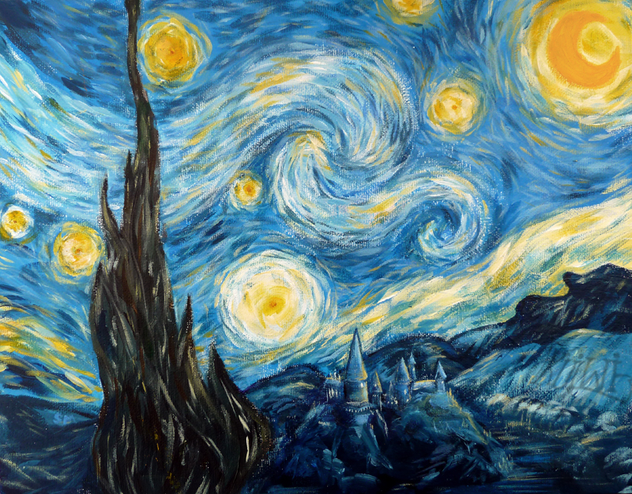
What is philosophy?
Russell characterizes philosophy as the area of study that critically addresses ultimate questions:
“philosophy is merely the attempt to answer such ultimate questions, not carelessly and dogmatically, as we do in ordinary life and even in the sciences, but critically, after exploring all that makes such questions puzzling, and after realizing all the vagueness and confusion that underlie our ordinary ideas.” (PP, p. 1)
“Philosophy, if it cannot answer so many questions as we could wish, has at least the power of asking questions which increase the interest of the world, and show the strangeness and wonder lying just below the surface even in the commonest things of daily life.” (PP, p. 6)

Slide 41
Philosophy as criticism
“Philosophical knowledge…does not differ essentially from scientific knowledge; there is no special source of wisdom which is open to philosophy but not to science, and the results obtained by philosophy are not radically different from those obtained by science. The essential characteristic of philosophy is criticism. It examines critically the principles employed in science and in daily life; it searches out any inconsistencies there may be in these principles, and it only accepts them when, as the result of critical inquiry, no reason for rejecting them has appeared.” (PP, p. 87)
“Philosophy, like all other studies, aims primarily at knowledge. The knowledge it aims at is the kind of knowledge which gives unity and system to the body of the sciences, and the kind which results from a critical examination of the grounds of our convictions, prejudices, and beliefs.” (PP, p. 90)

Slide 42
Value of philosophy
Philosophy frees us from prejudice, makes us more open-minded:
“The value of philosophy is, in fact, to be sought largely, in its very uncertainty…Philosophy…is able to suggest many possibilities which enlarge our thoughts and free them from the tyranny of custom. Thus, while diminishing our feeling of certainty as to what things are, it greatly increases our knowledge as to what they may be; it removes the somewhat arrogant dogmatism of those who have never travelled into the region of liberating doubt, and it keeps alive our sense of wonder by showing familiar things in an unfamiliar aspect.” (PP, p. 91)

Slide 43

Russell’s advice

Slide 44
bibliography
Russell, Bertrand (1912/1998). The Problems of Philosophy. Oxford UP

